Slide 1
Representative PERs for Lick Response Types
01/04/18

Slide 2
Final New PERs –Non Responsive
05/03/2018

Slide 3
CeA CRF OA2-1 RecDay 3B-08252016-EtOH- FULL SESSION-ALL FIN.nex5: Perievent Rasters
Analysis Type = Perievent Rasters
Ref. Type = Fixed
Reference = EventLick
XMin (sec) = -0.1
XMax (sec) = 0.1
Trial Order = First On Top
Sort Trials = None
Sort Event = First after reference
Sort Ref. = EVT02
Histogram = Below
Hist. Height(%) = 45
Bin (sec) = 0.01
Normalization = Spikes/Sec
No Selfcount = 1
Select Data = All
Select Data From (sec) = 0
Select Data To (sec) = 14891.6363
Int. Filter Type = Fixed
Interval Filter = None
Create Filter on-the-fly = 0
Create Filter around = EVT02
Start Offset (sec) = 0
End Offset (sec) = 1
Fix Overlaps = 1
Smooth Histogram = None
Sm. Width = 3
Add Bin Left to Results = 0
Add Bin Middle to Results = 0
Add Bin Right to Results = 0
Run Postproc. Script = 0
Postprocessing Script =
Postproc. Script Parameter =
Representative PER for Non Responsive (all units here are classified as non-responsive)
Data File: D:\Users\James\Dropbox (Sparta Lab)\CeA CRF DID Ephys - Cleaned\All Final Clean nex Files by Drink\DATA-EtOH Only\CeA CRF OA2-1 RecDay 3B-08252016-EtOH- FULL SESSION-ALL FIN.nex5
May 03, 2018 16:27:26

Slide 4
CeA CRF OA3-1_07262017_EtOH_FULL DID SESS_FIN.nex5: Perievent Rasters
Analysis Type = Perievent Rasters
Ref. Type = Fixed
Reference = EventLick
XMin (sec) = -0.1
XMax (sec) = 0.1
Trial Order = First On Top
Sort Trials = None
Sort Event = First after reference
Sort Ref. = EVT02
Histogram = Below
Hist. Height(%) = 45
Bin (sec) = 0.01
Normalization = Spikes/Sec
No Selfcount = 1
Select Data = All
Select Data From (sec) = 0
Select Data To (sec) = 14891.6363
Int. Filter Type = Fixed
Interval Filter = None
Create Filter on-the-fly = 0
Create Filter around = EVT02
Start Offset (sec) = 0
End Offset (sec) = 1
Fix Overlaps = 1
Smooth Histogram = None
Sm. Width = 3
Add Bin Left to Results = 0
Add Bin Middle to Results = 0
Add Bin Right to Results = 0
Run Postproc. Script = 0
Postprocessing Script =
Postproc. Script Parameter =
All CRF Non Responsive File 22
Data File: D:\Users\James\Dropbox (Sparta Lab)\CeA CRF DID Ephys - Cleaned\All Final Clean nex Files by Drink\DATA-EtOH Only\CeA CRF OA3-1_07262017_EtOH_FULL DID SESS_FIN.nex5
May 03, 2018 17:01:22

Slide 5
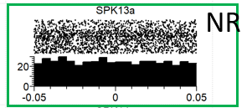
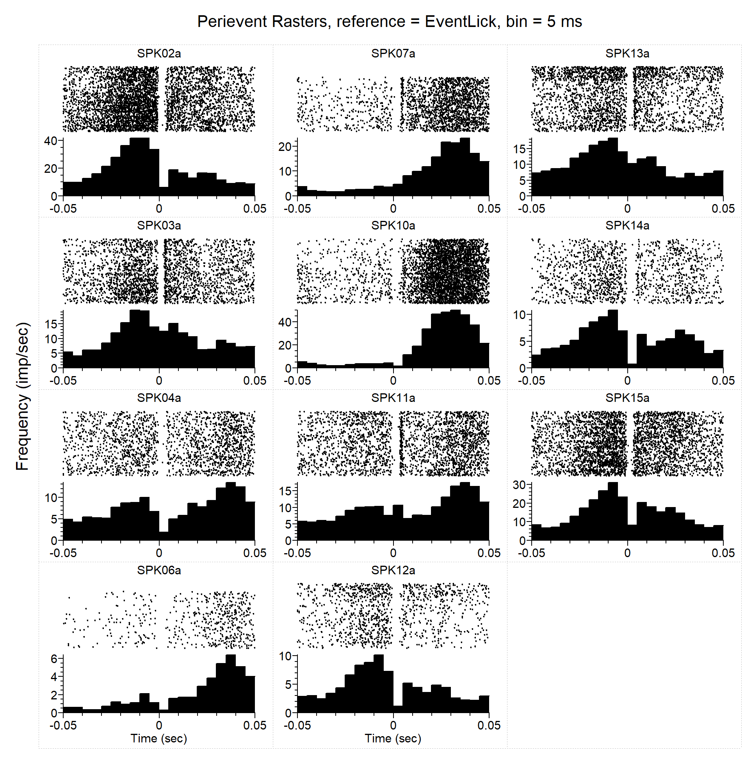
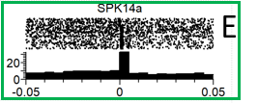
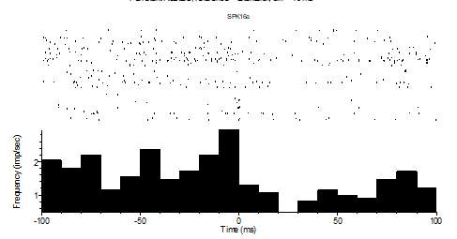
Current As of 01/04/18
CeA CRF OA3-2_07122017_FullSucr-FULL DID SESS-FIN.nex5
Only\CeA CRF OA2-3 Sucr-02032017_FULL SESSION_FIN.nex5
CeACROA2-1_0122017_2sucr-FULL SESSION_FIN.nex5
CeA CRF OA3-3_10202017_EtOH_FULL DID SESS-DID1_WIP-NoXChanNeeded_JUMP 12-16 for Lick Inh.nex5

Slide 6
PER - Licks
PE
E
Analysis Type = Perievent Rasters
Ref. Type = Fixed
Reference = EventLick
XMin (sec) = -0.05
XMax (sec) = 0.05
Trial Order = First On Top
Sort Trials = None
Sort Event = First after reference
Sort Ref. = EVT03
Histogram = Below
Hist. Height(%) = 45
Bin (sec) = 0.005
Normalization = Spikes/Sec
No Selfcount = 1
Select Data = All
Select Data From (sec) = 0
Select Data To (sec) = 1658.584275
Int. Filter Type = Fixed
Interval Filter = None
Create Filter on-the-fly = 0
Create Filter around = EVT03
Start Offset (sec) = 0
End Offset (sec) = 1
Fix Overlaps = 1
Smooth Histogram = None
Sm. Width = 3
Add Bin Left to Results = 0
Add Bin Middle to Results = 0
Add Bin Right to Results = 0
Run Postproc. Script = 0
Postprocessing Script =
Postproc. Script Parameter =
E
Data File: C:\Users\Sonia Aroni\Dropbox (Sparta Lab)\CeA CRF DID Ephys - Cleaned\All Final Clean nex Files by Drink\DATA-Sucr Only\CeA CRF OA2-3 Sucr-02032017_FULL SESSION_FIN.nex5
September 12, 2017 16:35:43

Slide 7
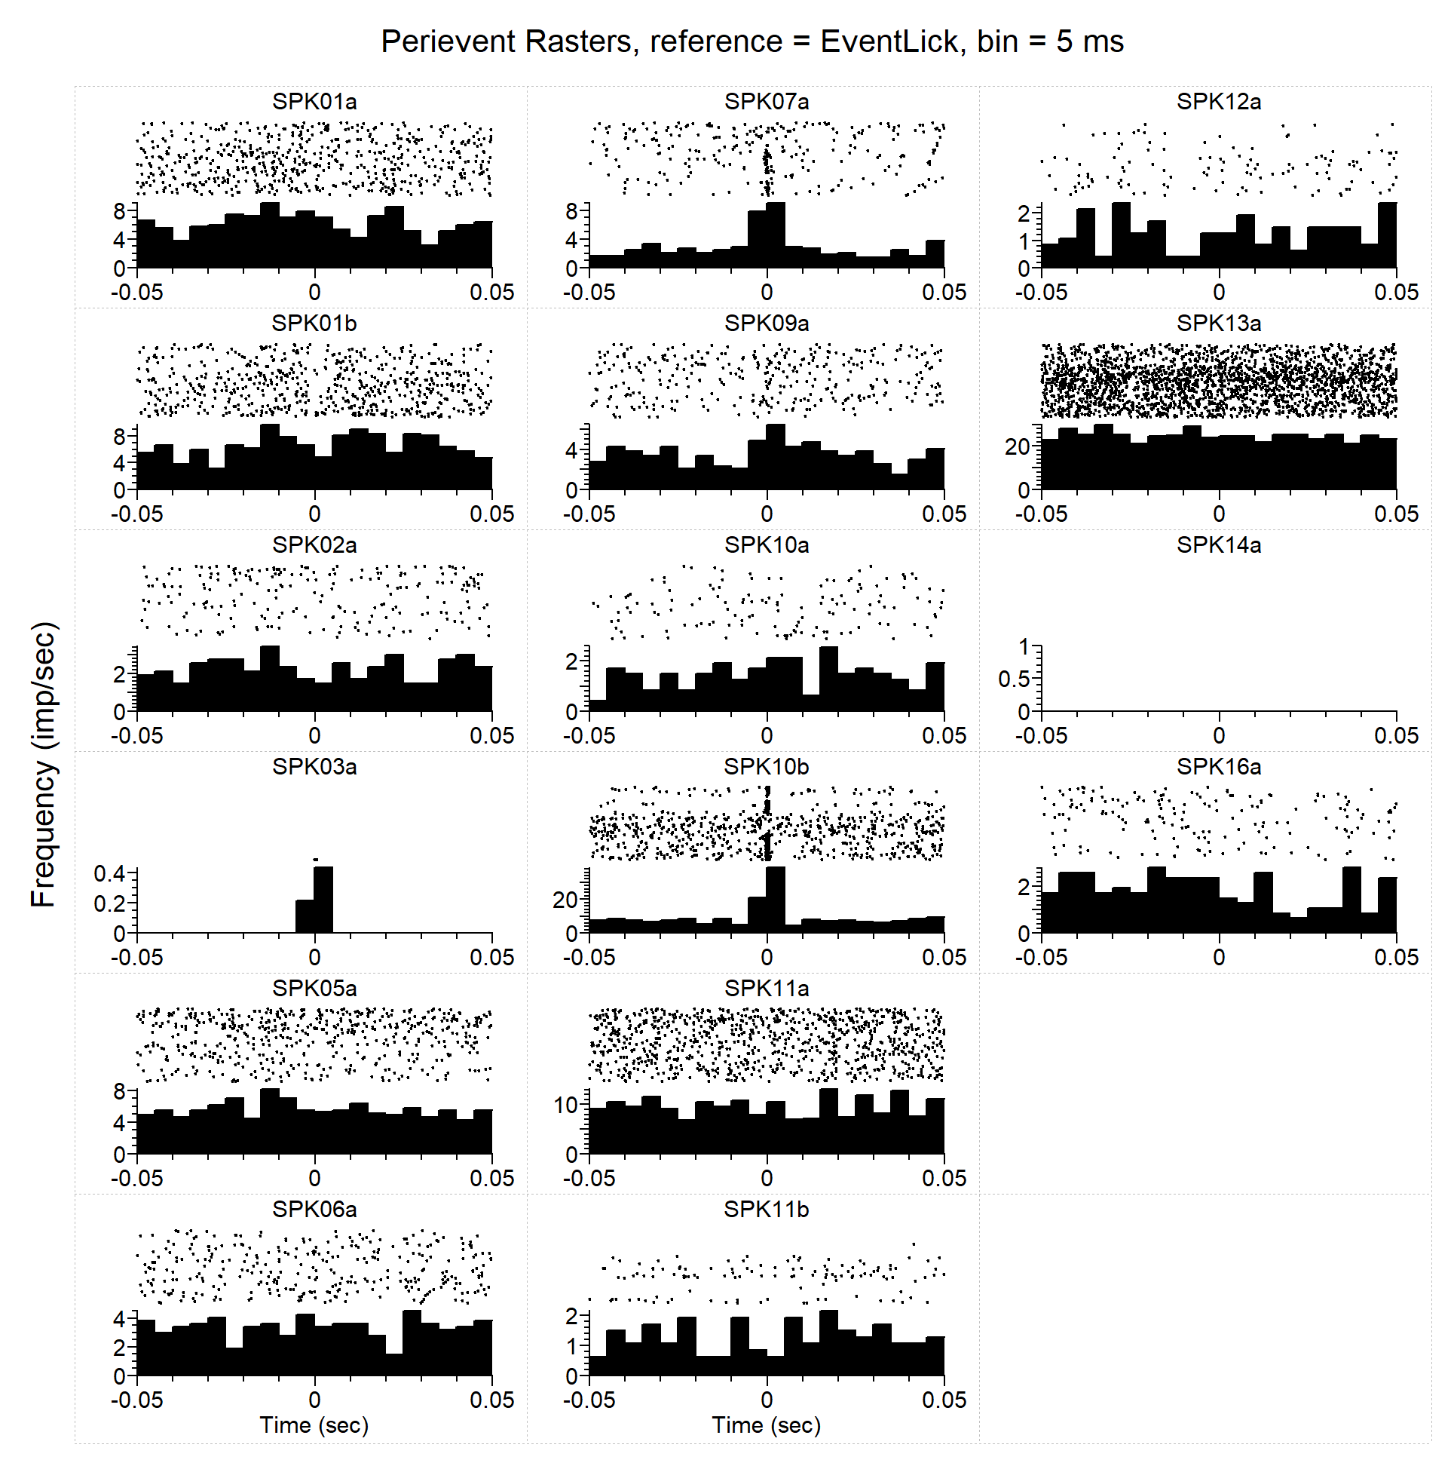
PER - Licks
Analysis Type = Perievent Rasters
Ref. Type = Fixed
Reference = EventLick
XMin (sec) = -0.05
XMax (sec) = 0.05
Trial Order = First On Top
Sort Trials = None
Sort Event = First after reference
Sort Ref. = EVT03
Histogram = Below
Hist. Height(%) = 45
Bin (sec) = 0.005
Normalization = Spikes/Sec
No Selfcount = 1
Select Data = All
Select Data From (sec) = 0
Select Data To (sec) = 1658.584275
Int. Filter Type = Fixed
Interval Filter = None
Create Filter on-the-fly = 0
Create Filter around = EVT03
Start Offset (sec) = 0
End Offset (sec) = 1
Fix Overlaps = 1
Smooth Histogram = None
Sm. Width = 3
Add Bin Left to Results = 0
Add Bin Middle to Results = 0
Add Bin Right to Results = 0
Run Postproc. Script = 0
Postprocessing Script =
Postproc. Script Parameter =
NR
Data File: C:\Users\Sonia Aroni\Dropbox (Sparta Lab)\CeA CRF DID Ephys - Cleaned\All Final Clean nex Files by Drink\DATA-Sucr Only\CeA CRF OA3-2_07122017_FullSucr-FULL DID SESS-FIN.nex5
September 12, 2017 16:39:37

Slide 8
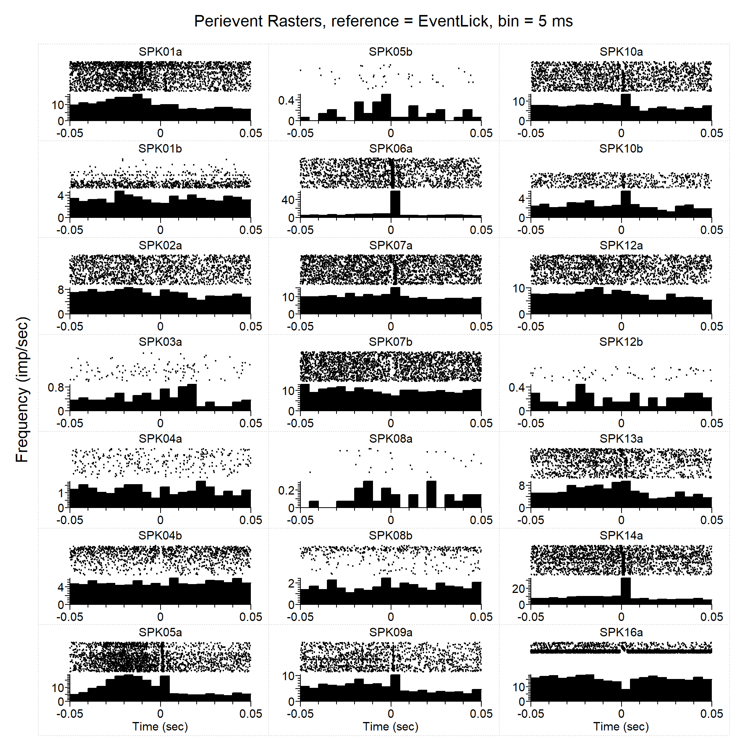
PER - Licks
Analysis Type = Perievent Rasters
Ref. Type = Fixed
Reference = EventLick
XMin (sec) = -0.05
XMax (sec) = 0.05
Trial Order = First On Top
Sort Trials = None
Sort Event = First after reference
Sort Ref. = EVT03
Histogram = Below
Hist. Height(%) = 45
Bin (sec) = 0.005
Normalization = Spikes/Sec
No Selfcount = 1
Select Data = All
Select Data From (sec) = 0
Select Data To (sec) = 1658.584275
Int. Filter Type = Fixed
Interval Filter = None
Create Filter on-the-fly = 0
Create Filter around = EVT03
Start Offset (sec) = 0
End Offset (sec) = 1
Fix Overlaps = 1
Smooth Histogram = None
Sm. Width = 3
Add Bin Left to Results = 0
Add Bin Middle to Results = 0
Add Bin Right to Results = 0
Run Postproc. Script = 0
Postprocessing Script =
Postproc. Script Parameter =
E
I
I
Data File: C:\Users\Sonia Aroni\Dropbox (Sparta Lab)\CeA CRF DID Ephys - Cleaned\All Final Clean nex Files by Drink\DATA-Sucr Only\CeACROA2-1_0122017_2sucr-FULL SESSION_FIN.nex5
September 12, 2017 16:42:15

Slide 9
CeA CRF OA3-3_10202017_EtOH_FULL DID SESS-DID1_002.pl2: Perievent Rasters
Analysis Type = Perievent Rasters
Ref. Type = Fixed
Reference = EventLick
XMin (sec) = -0.1
XMax (sec) = 0.1
Trial Order = First On Top
Sort Trials = None
Sort Event = First after reference
Sort Ref. = EVT02
Histogram = Below
Hist. Height(%) = 45
Bin (sec) = 0.005
Normalization = Spikes/Sec
No Selfcount = 1
Select Data = From Time Range
Select Data From (sec) = 0
Select Data To (sec) = 13053.916172325
Int. Filter Type = Fixed
Interval Filter = None
Create Filter on-the-fly = 0
Create Filter around = EVT02
Start Offset (sec) = 0
End Offset (sec) = 1
Fix Overlaps = 1
Smooth Histogram = None
Sm. Width = 3
Add Bin Left to Results = 0
Add Bin Middle to Results = 0
Add Bin Right to Results = 0
Run Postproc. Script = 0
Postprocessing Script =
Postproc. Script Parameter =
16a is lick inhibhitex
Data File: D:\Users\James\Dropbox (Sparta Lab)\Electrophysiology Data Backup\CeA CRF OA Batch3 - DID Ephys\CeA CRF OA3-3_10202017_EtOH\Split Files\CeA CRF OA3-3_10202017_EtOH_FULL DID SESS-DID1_002.pl2
November 06, 2017 20:34:19

Slide 10
Original PPT From Sonia
“representative rate histograms+autocorrelograms +traces.ppt”

Slide 11
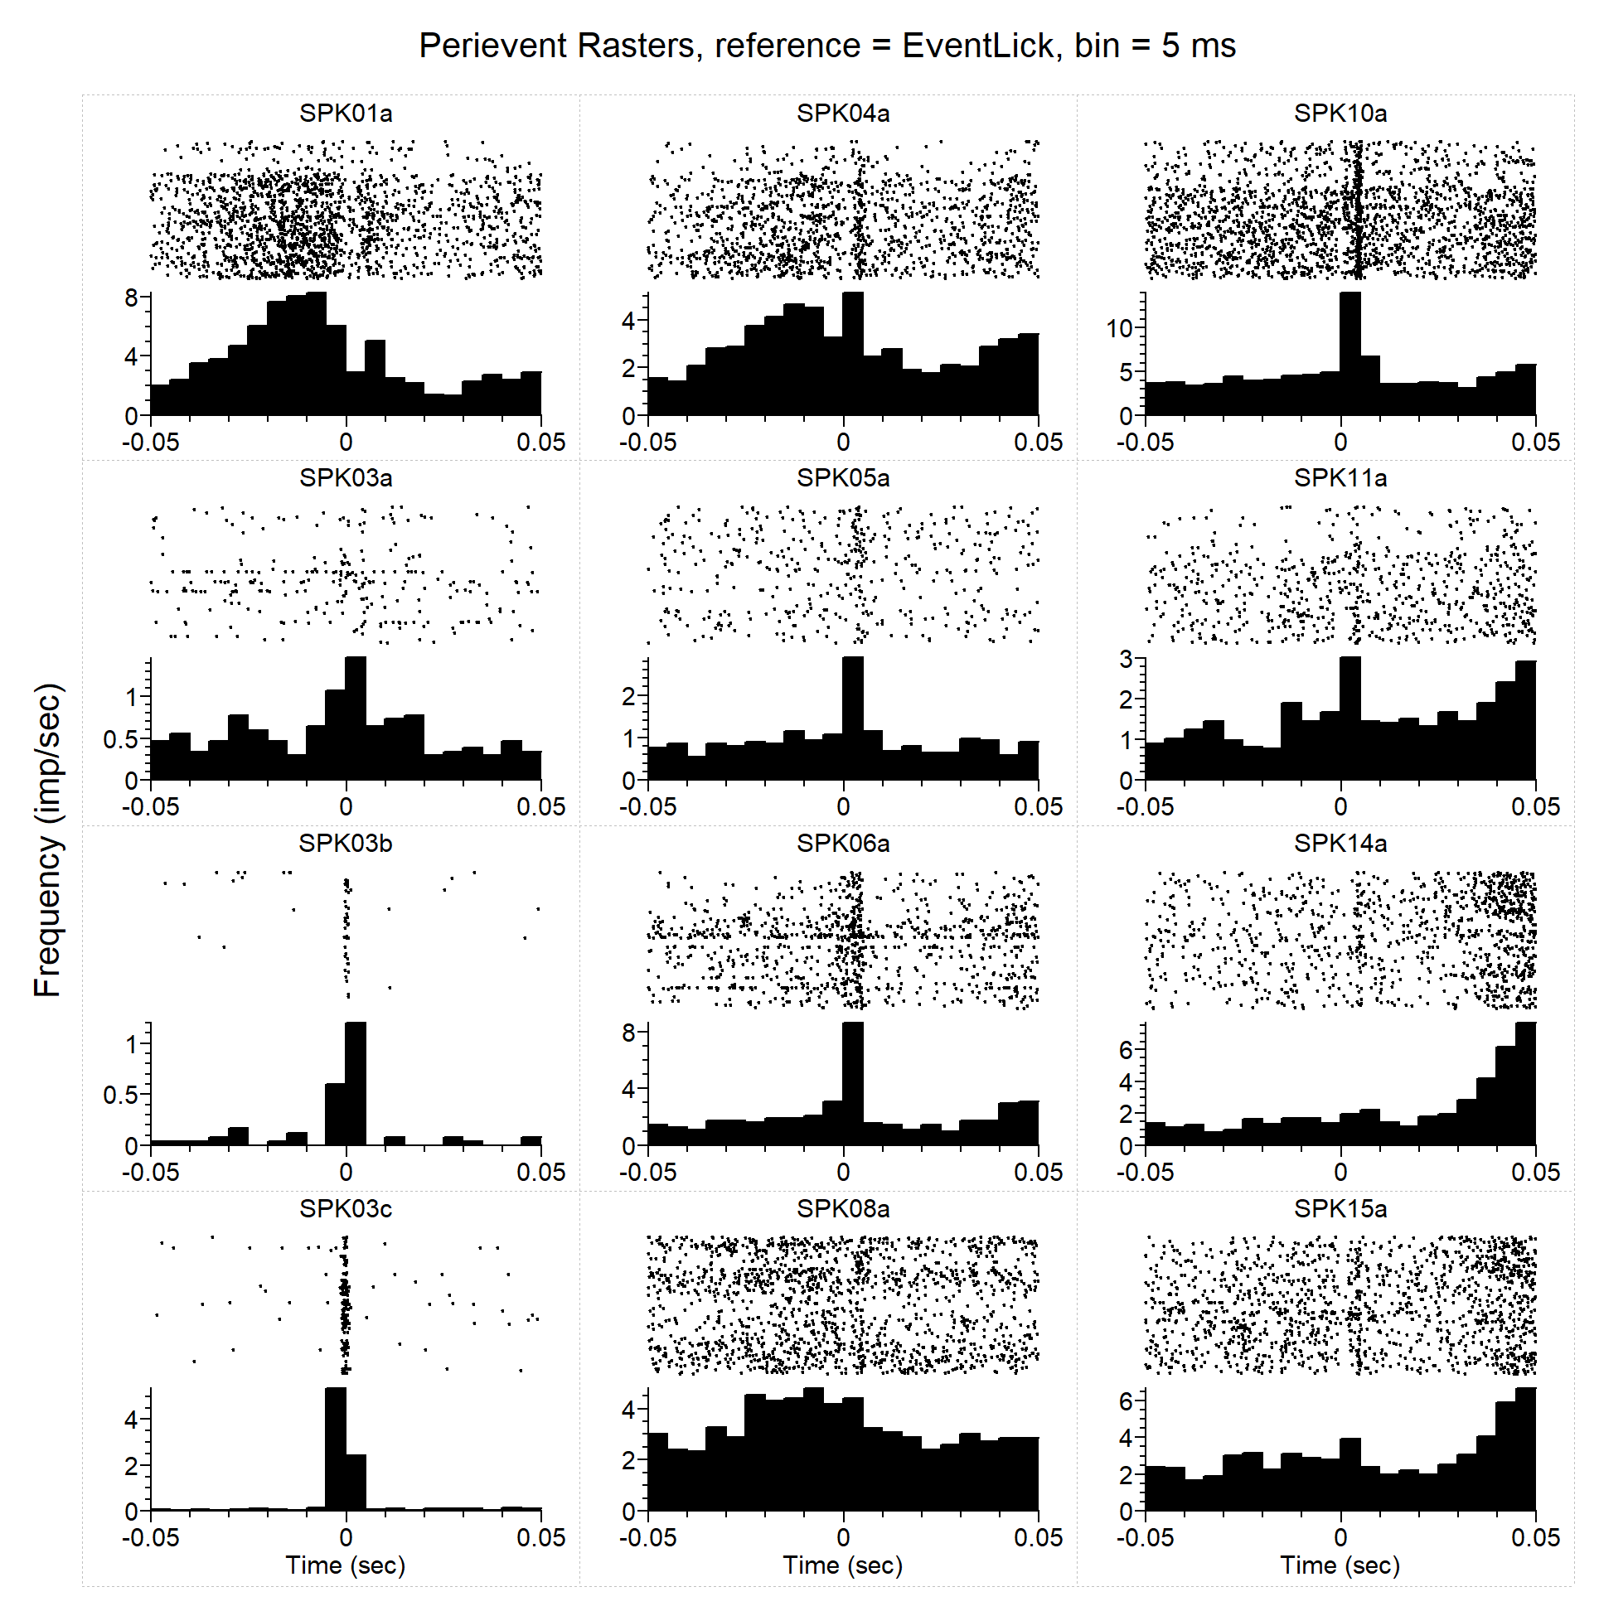
PER - Licks
PE
E
Analysis Type = Perievent Rasters
Ref. Type = Fixed
Reference = EventLick
XMin (sec) = -0.05
XMax (sec) = 0.05
Trial Order = First On Top
Sort Trials = None
Sort Event = First after reference
Sort Ref. = EVT03
Histogram = Below
Hist. Height(%) = 45
Bin (sec) = 0.005
Normalization = Spikes/Sec
No Selfcount = 1
Select Data = All
Select Data From (sec) = 0
Select Data To (sec) = 1658.584275
Int. Filter Type = Fixed
Interval Filter = None
Create Filter on-the-fly = 0
Create Filter around = EVT03
Start Offset (sec) = 0
End Offset (sec) = 1
Fix Overlaps = 1
Smooth Histogram = None
Sm. Width = 3
Add Bin Left to Results = 0
Add Bin Middle to Results = 0
Add Bin Right to Results = 0
Run Postproc. Script = 0
Postprocessing Script =
Postproc. Script Parameter =
Data File: C:\Users\Sonia Aroni\Dropbox (Sparta Lab)\CeA CRF DID Ephys - Cleaned\All Final Clean nex Files by Drink\DATA-Sucr Only\CeA CRF OA 2-2 Sucr 02072017_FULL SESSION-01_FIN.nex5
September 12, 2017 15:45:37

Slide 12
PER - Licks
PE
E
Analysis Type = Perievent Rasters
Ref. Type = Fixed
Reference = EventLick
XMin (sec) = -0.05
XMax (sec) = 0.05
Trial Order = First On Top
Sort Trials = None
Sort Event = First after reference
Sort Ref. = EVT03
Histogram = Below
Hist. Height(%) = 45
Bin (sec) = 0.005
Normalization = Spikes/Sec
No Selfcount = 1
Select Data = All
Select Data From (sec) = 0
Select Data To (sec) = 1658.584275
Int. Filter Type = Fixed
Interval Filter = None
Create Filter on-the-fly = 0
Create Filter around = EVT03
Start Offset (sec) = 0
End Offset (sec) = 1
Fix Overlaps = 1
Smooth Histogram = None
Sm. Width = 3
Add Bin Left to Results = 0
Add Bin Middle to Results = 0
Add Bin Right to Results = 0
Run Postproc. Script = 0
Postprocessing Script =
Postproc. Script Parameter =
E
Data File: C:\Users\Sonia Aroni\Dropbox (Sparta Lab)\CeA CRF DID Ephys - Cleaned\All Final Clean nex Files by Drink\DATA-Sucr Only\CeA CRF OA2-3 Sucr-02032017_FULL SESSION_FIN.nex5
September 12, 2017 16:35:43

Slide 13
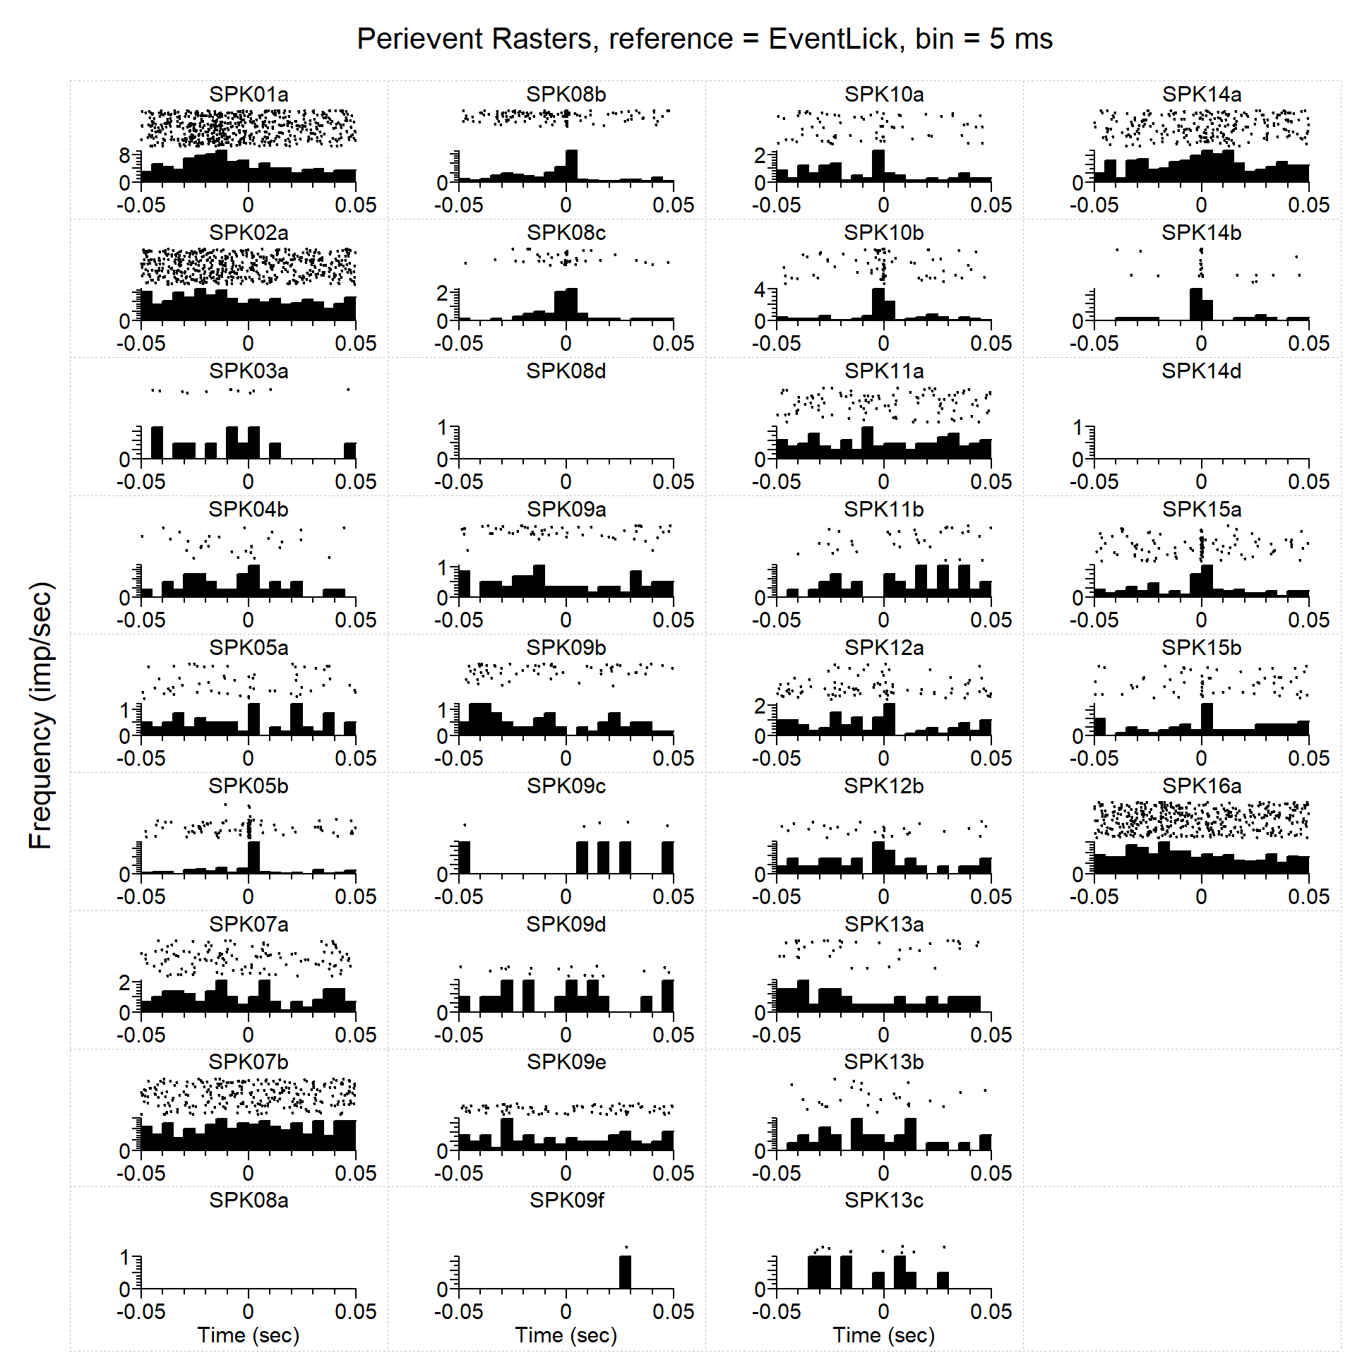
PER - Licks
Analysis Type = Perievent Rasters
Ref. Type = Fixed
Reference = EventLick
XMin (sec) = -0.05
XMax (sec) = 0.05
Trial Order = First On Top
Sort Trials = None
Sort Event = First after reference
Sort Ref. = EVT03
Histogram = Below
Hist. Height(%) = 45
Bin (sec) = 0.005
Normalization = Spikes/Sec
No Selfcount = 1
Select Data = All
Select Data From (sec) = 0
Select Data To (sec) = 1658.584275
Int. Filter Type = Fixed
Interval Filter = None
Create Filter on-the-fly = 0
Create Filter around = EVT03
Start Offset (sec) = 0
End Offset (sec) = 1
Fix Overlaps = 1
Smooth Histogram = None
Sm. Width = 3
Add Bin Left to Results = 0
Add Bin Middle to Results = 0
Add Bin Right to Results = 0
Run Postproc. Script = 0
Postprocessing Script =
Postproc. Script Parameter =
Data File: C:\Users\Sonia Aroni\Dropbox (Sparta Lab)\CeA CRF DID Ephys - Cleaned\All Final Clean nex Files by Drink\DATA-Sucr Only\CeA CRF OA3-1_07072017_Sucr_FULL DID SESS-PostPT1+2-Ch16Done-FIN.nex5
September 12, 2017 16:38:11

Slide 14
PER - Licks
Analysis Type = Perievent Rasters
Ref. Type = Fixed
Reference = EventLick
XMin (sec) = -0.05
XMax (sec) = 0.05
Trial Order = First On Top
Sort Trials = None
Sort Event = First after reference
Sort Ref. = EVT03
Histogram = Below
Hist. Height(%) = 45
Bin (sec) = 0.005
Normalization = Spikes/Sec
No Selfcount = 1
Select Data = All
Select Data From (sec) = 0
Select Data To (sec) = 1658.584275
Int. Filter Type = Fixed
Interval Filter = None
Create Filter on-the-fly = 0
Create Filter around = EVT03
Start Offset (sec) = 0
End Offset (sec) = 1
Fix Overlaps = 1
Smooth Histogram = None
Sm. Width = 3
Add Bin Left to Results = 0
Add Bin Middle to Results = 0
Add Bin Right to Results = 0
Run Postproc. Script = 0
Postprocessing Script =
Postproc. Script Parameter =
NR
Data File: C:\Users\Sonia Aroni\Dropbox (Sparta Lab)\CeA CRF DID Ephys - Cleaned\All Final Clean nex Files by Drink\DATA-Sucr Only\CeA CRF OA3-2_07122017_FullSucr-FULL DID SESS-FIN.nex5
September 12, 2017 16:39:37

Slide 15
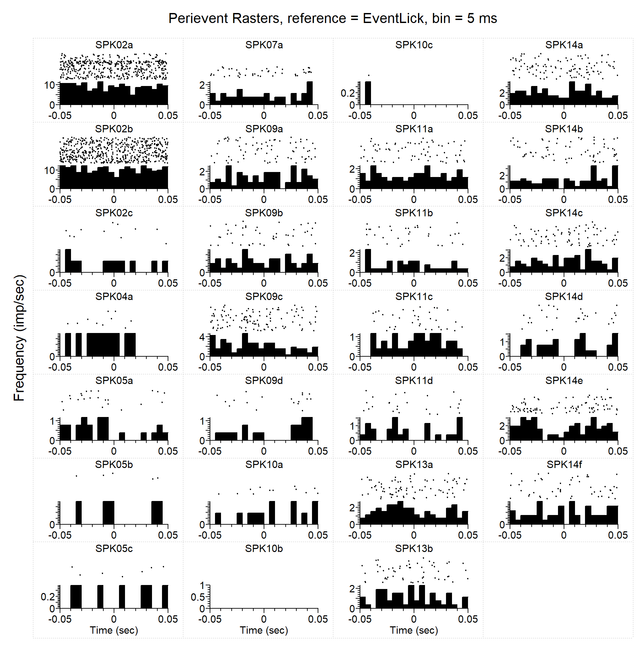
PER - Licks
R
Analysis Type = Perievent Rasters
Ref. Type = Fixed
Reference = EventLick
XMin (sec) = -0.05
XMax (sec) = 0.05
Trial Order = First On Top
Sort Trials = None
Sort Event = First after reference
Sort Ref. = EVT03
Histogram = Below
Hist. Height(%) = 45
Bin (sec) = 0.005
Normalization = Spikes/Sec
No Selfcount = 1
Select Data = All
Select Data From (sec) = 0
Select Data To (sec) = 1658.584275
Int. Filter Type = Fixed
Interval Filter = None
Create Filter on-the-fly = 0
Create Filter around = EVT03
Start Offset (sec) = 0
End Offset (sec) = 1
Fix Overlaps = 1
Smooth Histogram = None
Sm. Width = 3
Add Bin Left to Results = 0
Add Bin Middle to Results = 0
Add Bin Right to Results = 0
Run Postproc. Script = 0
Postprocessing Script =
Postproc. Script Parameter =
Data File: C:\Users\Sonia Aroni\Dropbox (Sparta Lab)\CeA CRF DID Ephys - Cleaned\All Final Clean nex Files by Drink\DATA-Sucr Only\CeA CRF OA3-5_07192017_sucr_FULL DID SESS-XChanRemoved-pass1FIN.nex5
September 12, 2017 16:40:57

Slide 16
PER - Licks
Analysis Type = Perievent Rasters
Ref. Type = Fixed
Reference = EventLick
XMin (sec) = -0.05
XMax (sec) = 0.05
Trial Order = First On Top
Sort Trials = None
Sort Event = First after reference
Sort Ref. = EVT03
Histogram = Below
Hist. Height(%) = 45
Bin (sec) = 0.005
Normalization = Spikes/Sec
No Selfcount = 1
Select Data = All
Select Data From (sec) = 0
Select Data To (sec) = 1658.584275
Int. Filter Type = Fixed
Interval Filter = None
Create Filter on-the-fly = 0
Create Filter around = EVT03
Start Offset (sec) = 0
End Offset (sec) = 1
Fix Overlaps = 1
Smooth Histogram = None
Sm. Width = 3
Add Bin Left to Results = 0
Add Bin Middle to Results = 0
Add Bin Right to Results = 0
Run Postproc. Script = 0
Postprocessing Script =
Postproc. Script Parameter =
E
I
I
Data File: C:\Users\Sonia Aroni\Dropbox (Sparta Lab)\CeA CRF DID Ephys - Cleaned\All Final Clean nex Files by Drink\DATA-Sucr Only\CeACROA2-1_0122017_2sucr-FULL SESSION_FIN.nex5
September 12, 2017 16:42:15

Slide 17
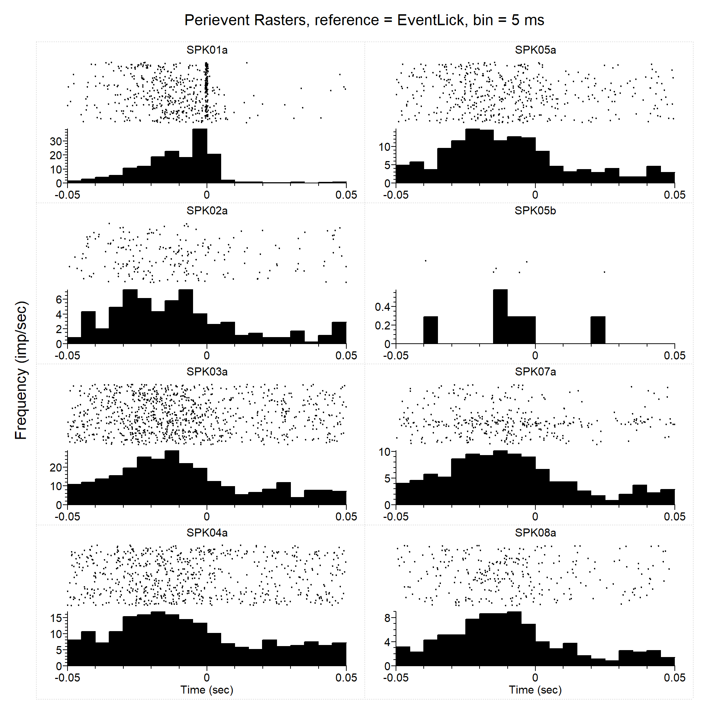
PER - Licks
I
Analysis Type = Perievent Rasters
Ref. Type = Fixed
Reference = EventLick
XMin (sec) = -0.05
XMax (sec) = 0.05
Trial Order = First On Top
Sort Trials = None
Sort Event = First after reference
Sort Ref. = EVT03
Histogram = Below
Hist. Height(%) = 45
Bin (sec) = 0.005
Normalization = Spikes/Sec
No Selfcount = 1
Select Data = All
Select Data From (sec) = 0
Select Data To (sec) = 1658.584275
Int. Filter Type = Fixed
Interval Filter = None
Create Filter on-the-fly = 0
Create Filter around = EVT03
Start Offset (sec) = 0
End Offset (sec) = 1
Fix Overlaps = 1
Smooth Histogram = None
Sm. Width = 3
Add Bin Left to Results = 0
Add Bin Middle to Results = 0
Add Bin Right to Results = 0
Run Postproc. Script = 0
Postprocessing Script =
Postproc. Script Parameter =
I
I
I
Data File: C:\Users\Sonia Aroni\Dropbox (Sparta Lab)\CeA CRF DID Ephys - Cleaned\All Final Clean nex Files by Drink\DATA-EtOH Only\CeACRFOA2-5_RD5_12122016_FULL SESSION_Ch0030407_FIN.nex5
September 12, 2017 17:01:33

Slide 18
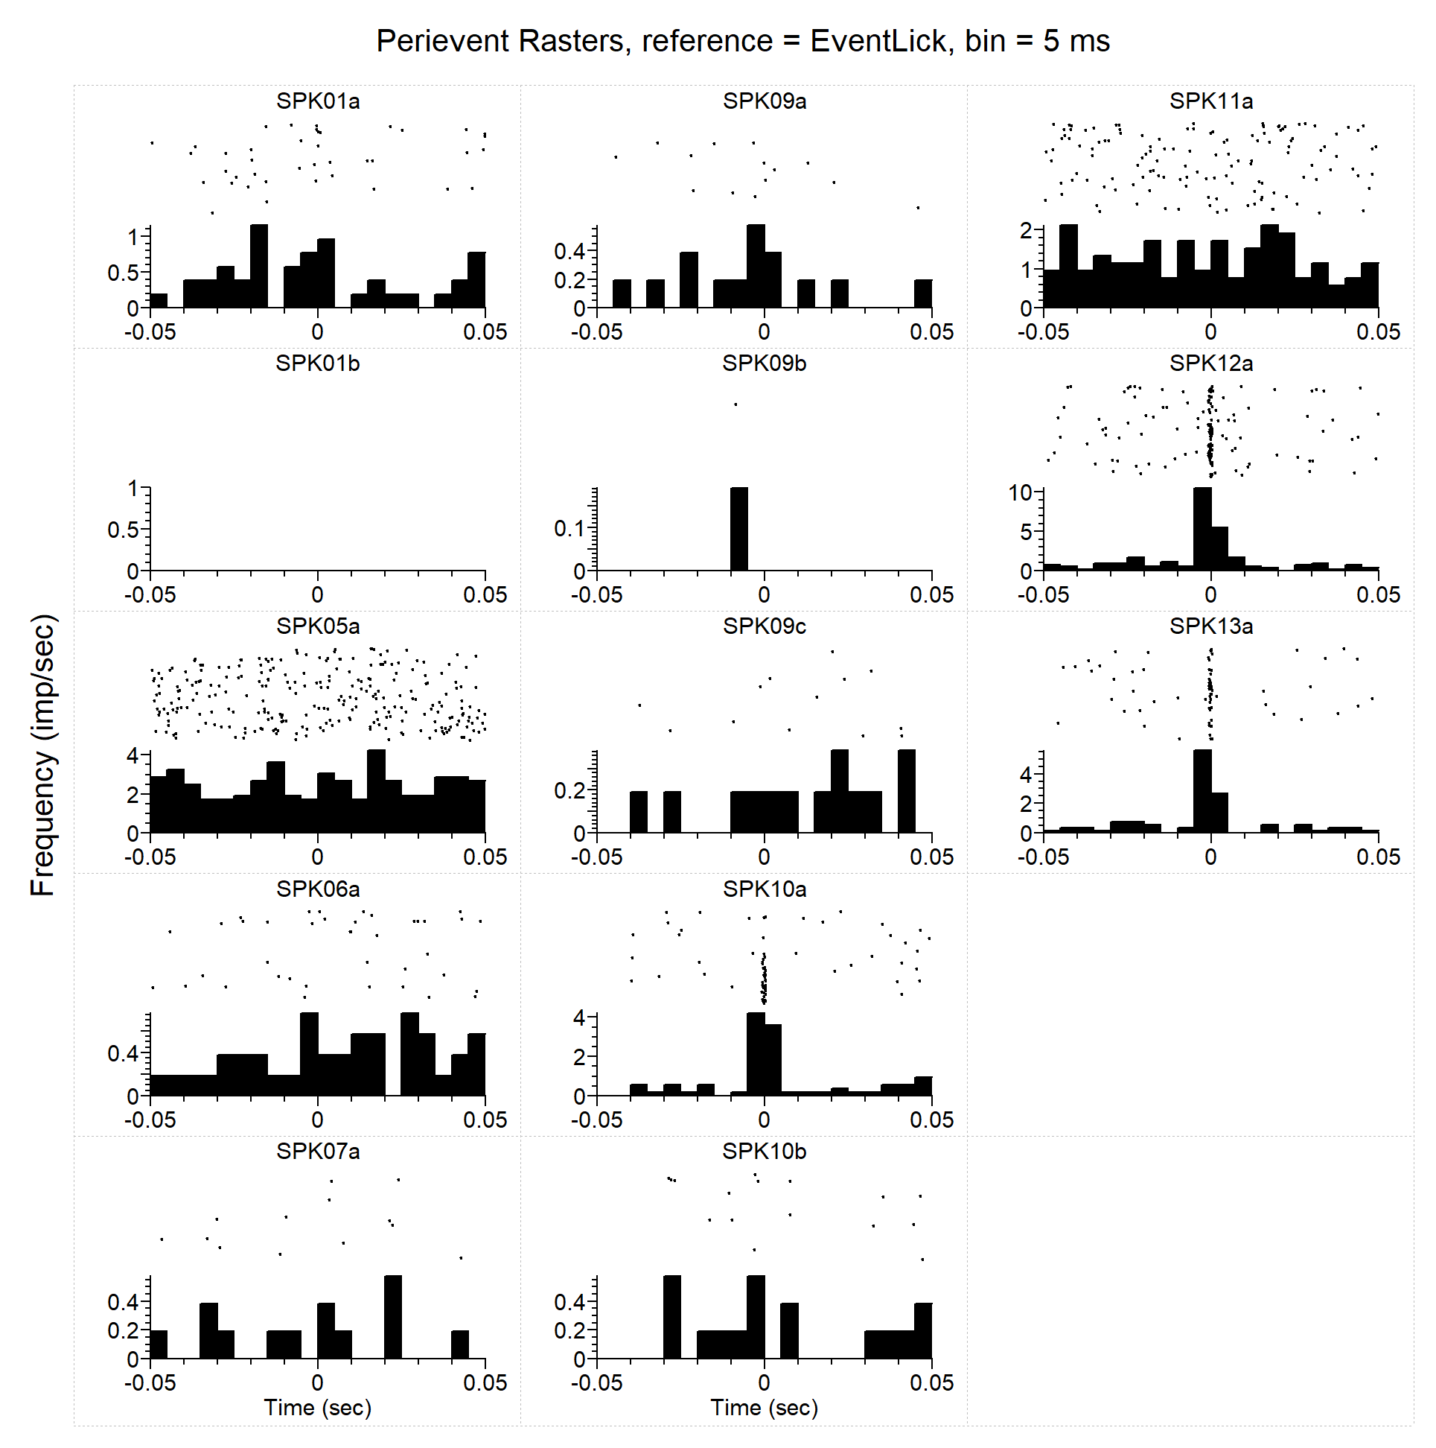
PER - Licks
Analysis Type = Perievent Rasters
Ref. Type = Fixed
Reference = EventLick
XMin (sec) = -0.05
XMax (sec) = 0.05
Trial Order = First On Top
Sort Trials = None
Sort Event = First after reference
Sort Ref. = EVT03
Histogram = Below
Hist. Height(%) = 45
Bin (sec) = 0.005
Normalization = Spikes/Sec
No Selfcount = 1
Select Data = All
Select Data From (sec) = 0
Select Data To (sec) = 1658.584275
Int. Filter Type = Fixed
Interval Filter = None
Create Filter on-the-fly = 0
Create Filter around = EVT03
Start Offset (sec) = 0
End Offset (sec) = 1
Fix Overlaps = 1
Smooth Histogram = None
Sm. Width = 3
Add Bin Left to Results = 0
Add Bin Middle to Results = 0
Add Bin Right to Results = 0
Run Postproc. Script = 0
Postprocessing Script =
Postproc. Script Parameter =
Data File: C:\Users\Sonia Aroni\Dropbox (Sparta Lab)\CeA CRF DID Ephys - Cleaned\All Final Clean nex Files by Drink\DATA-EtOH Only\CeA CRF OA2-1 RecDay 3B-08252016-EtOH- FULL SESSION-ALL FIN.nex5
September 12, 2017 17:07:23

Slide 19
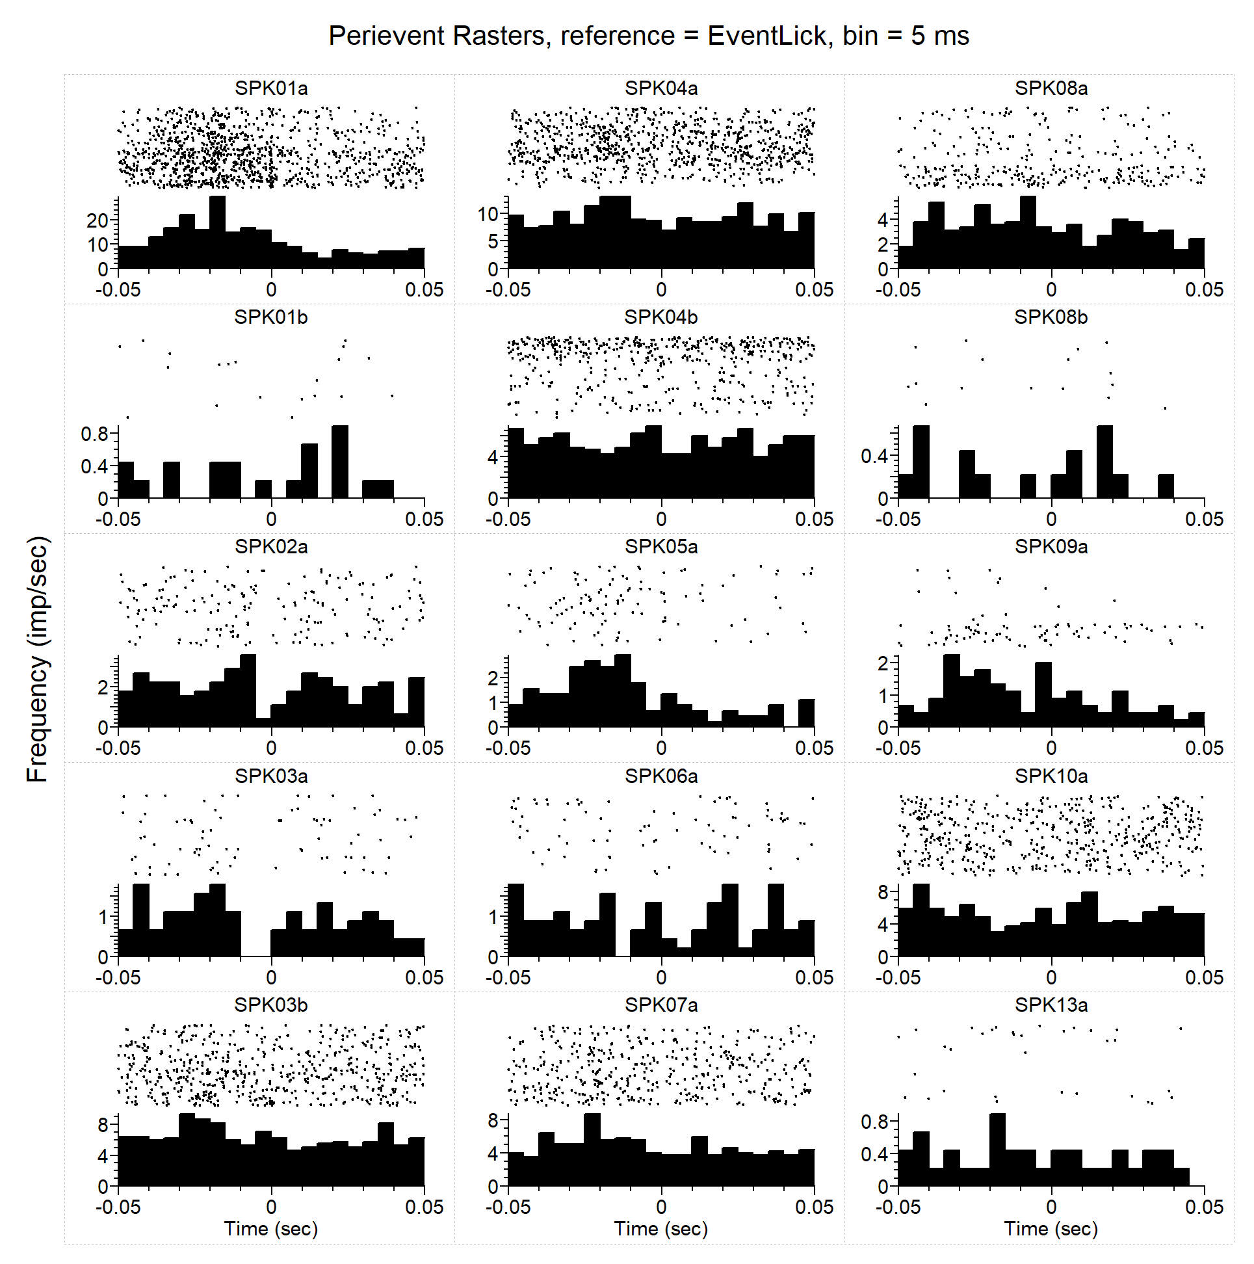
PER - Licks
I
Analysis Type = Perievent Rasters
Ref. Type = Fixed
Reference = EventLick
XMin (sec) = -0.05
XMax (sec) = 0.05
Trial Order = First On Top
Sort Trials = None
Sort Event = First after reference
Sort Ref. = EVT03
Histogram = Below
Hist. Height(%) = 45
Bin (sec) = 0.005
Normalization = Spikes/Sec
No Selfcount = 1
Select Data = All
Select Data From (sec) = 0
Select Data To (sec) = 1658.584275
Int. Filter Type = Fixed
Interval Filter = None
Create Filter on-the-fly = 0
Create Filter around = EVT03
Start Offset (sec) = 0
End Offset (sec) = 1
Fix Overlaps = 1
Smooth Histogram = None
Sm. Width = 3
Add Bin Left to Results = 0
Add Bin Middle to Results = 0
Add Bin Right to Results = 0
Run Postproc. Script = 0
Postprocessing Script =
Postproc. Script Parameter =
Data File: C:\Users\Sonia Aroni\Dropbox (Sparta Lab)\CeA CRF DID Ephys - Cleaned\All Final Clean nex Files by Drink\DATA-EtOH Only\CeA CRF OA2-1 RD5-1 01182017-FULL SESSION_FIN+DIDSessInts.nex5
September 12, 2017 17:08:33

Slide 20
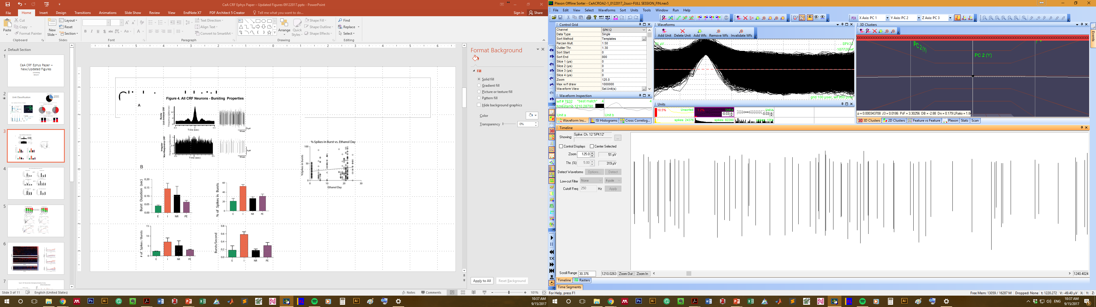
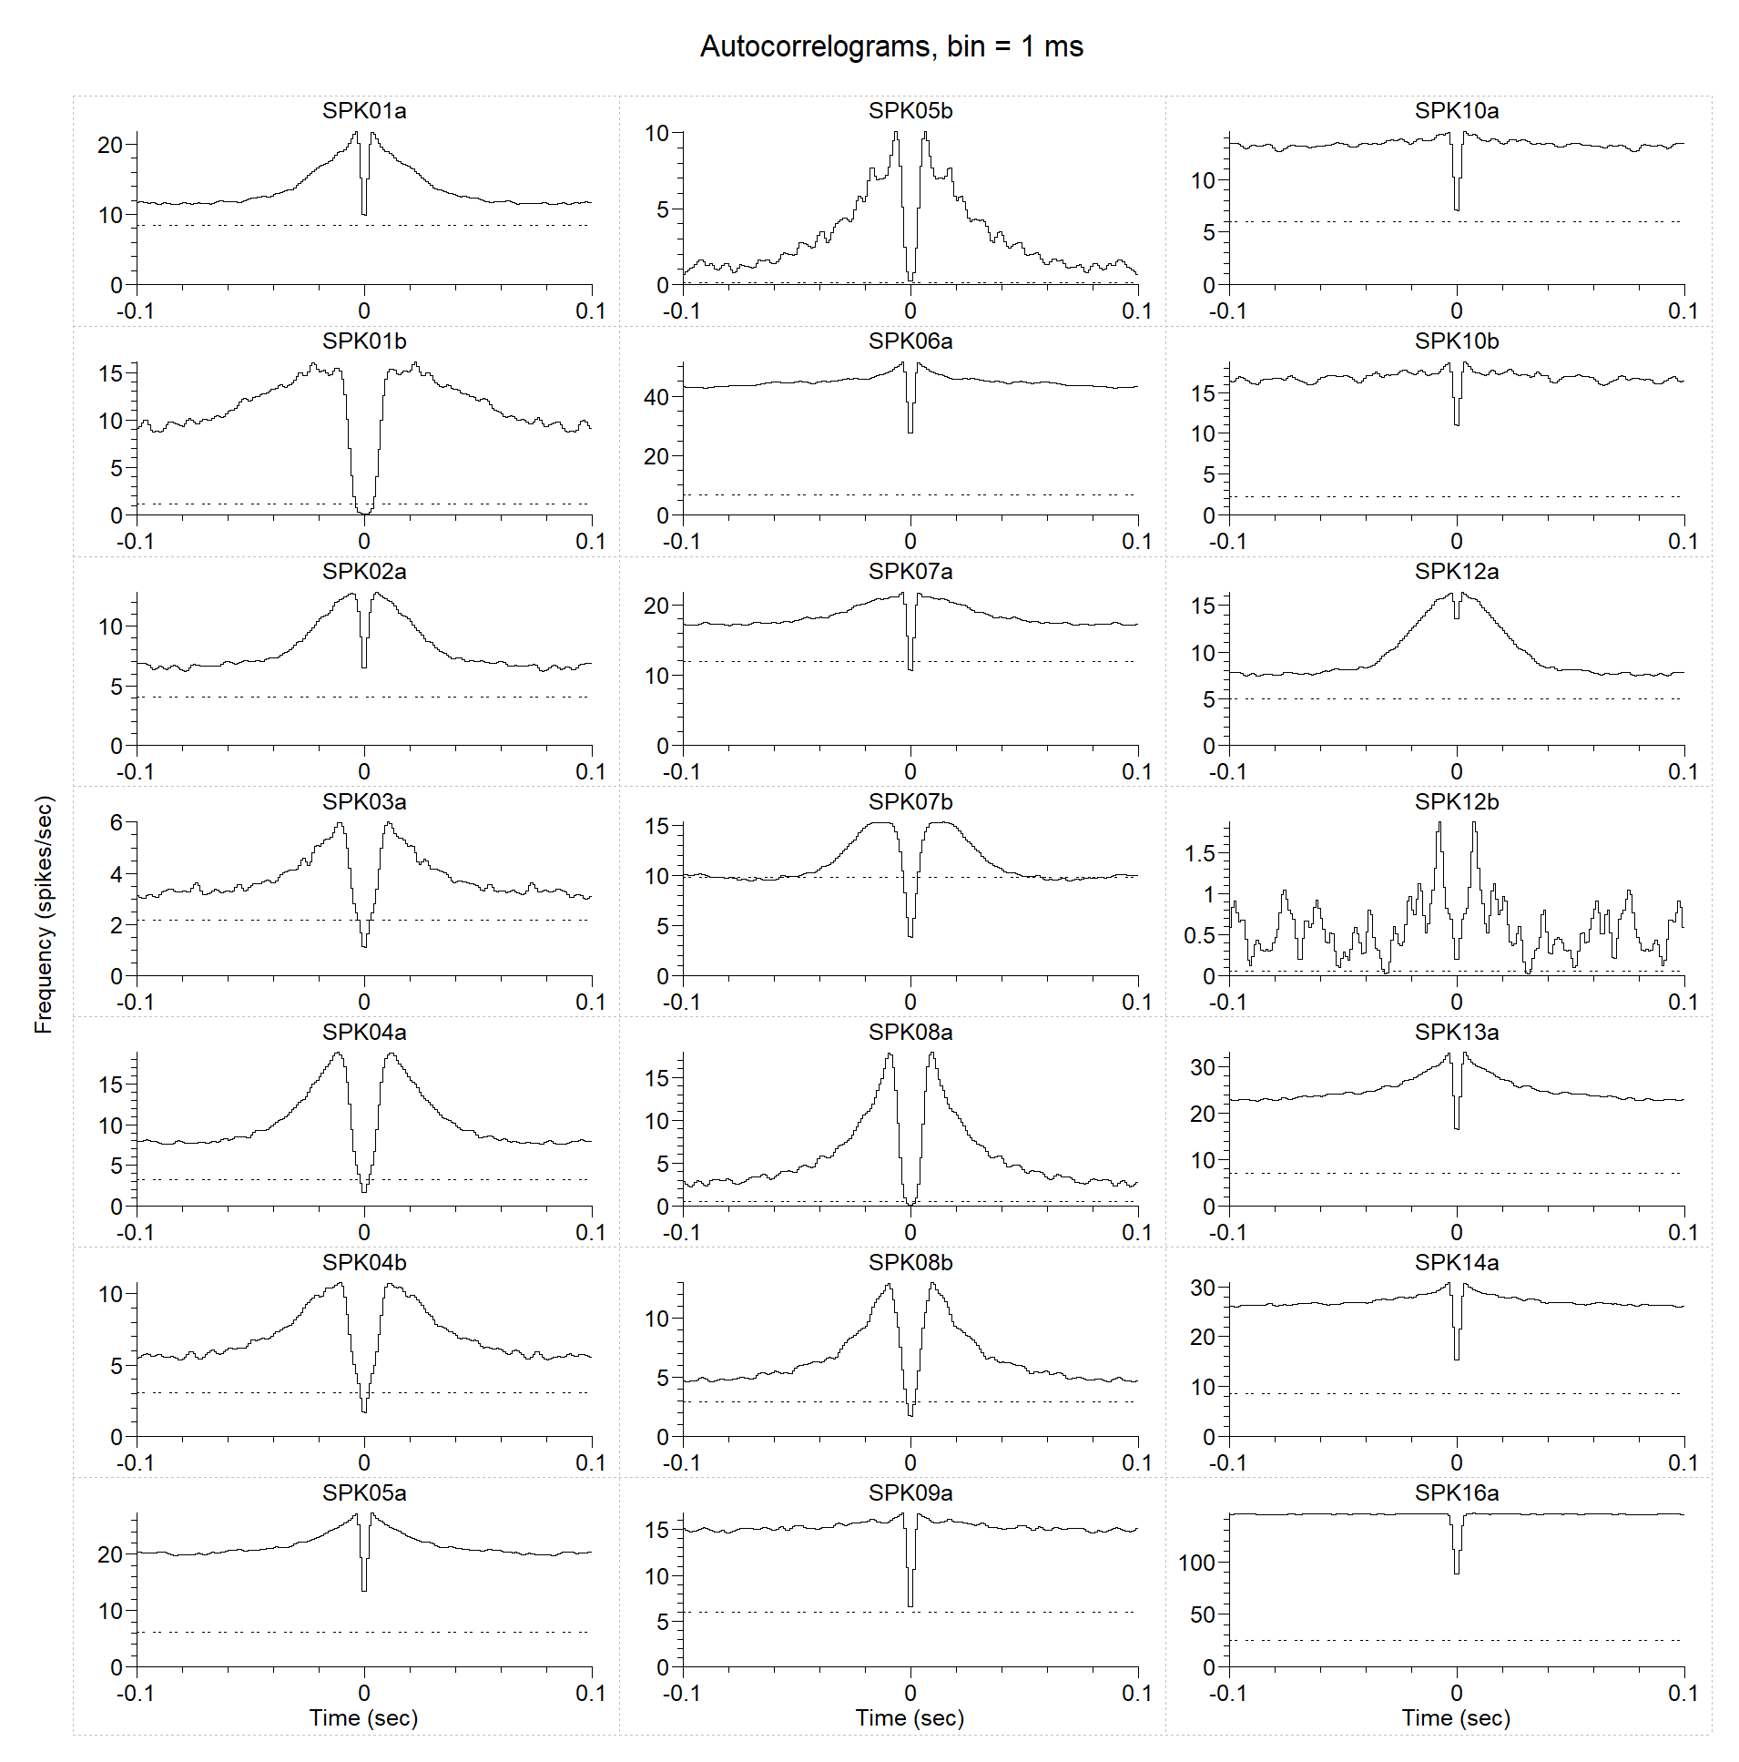
Autocorrelogram- Full Session
Analysis Type = Autocorrelograms
XMin (sec) = -0.1
XMax (sec) = 0.1
Bin (sec) = 0.001
Normalization = Spikes/Sec
Smooth = Gauss
Sm. Width = 3
Select Data = All
Select Data From (sec) = 0
Select Data To (sec) = 16463.6813
Int. Filter Type = Fixed
Interval Filter = None
Create Filter on-the-fly = 0
Create Filter around = EVT01
Start Offset (sec) = 0
End Offset (sec) = 1
Fix Overlaps = 1
Overlay Graphs = None
Draw Confidence Limits = 0
Confidence (%) = 99
Conf. Mean Calculation = Use data selection
Conf. Display = Colored Background
Conf. Line Style = Dashed
Conf. Background Color = (208;208;208)
Draw Mean Freq. = 1
Mean Line Style = Dotted
Add Bin Left to Results = 0
Add Bin Middle to Results = 0
Add Bin Right to Results = 0
Run Postproc. Script = 0
Postprocessing Script =
Postproc. Script Parameter =
Regular pattern
30 s trace
Data File: C:\Users\Sonia Aroni\Dropbox (Sparta Lab)\CeA CRF DID Ephys - Cleaned\All Final Clean nex Files by Drink\DATA-Sucr Only\CeACROA2-1_0122017_2sucr-FULL SESSION_FIN.nex5
September 12, 2017 16:42:23

Slide 21
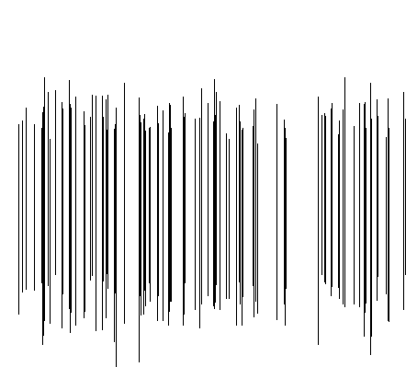
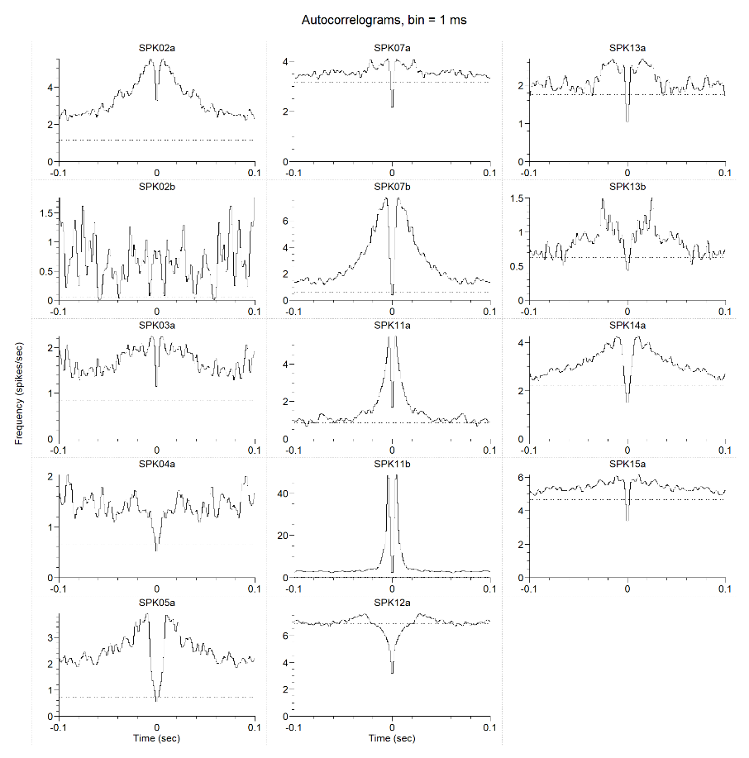
Autocorrelogram- Full Session
Analysis Type = Autocorrelograms
XMin (sec) = -0.1
XMax (sec) = 0.1
Bin (sec) = 0.001
Normalization = Spikes/Sec
Smooth = Gauss
Sm. Width = 3
Select Data = All
Select Data From (sec) = 0
Select Data To (sec) = 16625.684375
Int. Filter Type = Fixed
Interval Filter = None
Create Filter on-the-fly = 0
Create Filter around = EVT01
Start Offset (sec) = 0
End Offset (sec) = 1
Fix Overlaps = 1
Overlay Graphs = None
Draw Confidence Limits = 0
Confidence (%) = 99
Conf. Mean Calculation = Use data selection
Conf. Display = Colored Background
Conf. Line Style = Dashed
Conf. Background Color = (208;208;208)
Draw Mean Freq. = 1
Mean Line Style = Dotted
Add Bin Left to Results = 0
Add Bin Middle to Results = 0
Add Bin Right to Results = 0
Run Postproc. Script = 0
Postprocessing Script =
Postproc. Script Parameter =
bursty pattern
30s trace
Data File: C:\Users\Sonia Aroni\Dropbox (Sparta Lab)\CeA CRF DID Ephys - Cleaned\All Final Clean nex Files by Drink\DATA-EtOH Only\CeA CRF OA2-3 RD3 08302016- FULL SESSION-FIN.nex5
September 12, 2017 17:06:02

Slide 22
PER - Licks
E
Analysis Type = Perievent Rasters
Ref. Type = Fixed
Reference = EventLick
XMin (sec) = -0.05
XMax (sec) = 0.05
Trial Order = First On Top
Sort Trials = None
Sort Event = First after reference
Sort Ref. = EVT03
Histogram = Below
Hist. Height(%) = 45
Bin (sec) = 0.005
Normalization = Spikes/Sec
No Selfcount = 1
Select Data = All
Select Data From (sec) = 0
Select Data To (sec) = 1658.584275
Int. Filter Type = Fixed
Interval Filter = None
Create Filter on-the-fly = 0
Create Filter around = EVT03
Start Offset (sec) = 0
End Offset (sec) = 1
Fix Overlaps = 1
Smooth Histogram = None
Sm. Width = 3
Add Bin Left to Results = 0
Add Bin Middle to Results = 0
Add Bin Right to Results = 0
Run Postproc. Script = 0
Postprocessing Script =
Postproc. Script Parameter =
Data File: C:\Users\Sonia Aroni\Dropbox (Sparta Lab)\CeA CRF DID Ephys - Cleaned\All Final Clean nex Files by Drink\DATA-Sucr Only\CeACROA2-1_0122017_2sucr-FULL SESSION_FIN.nex5
September 12, 2017 16:42:15

Slide 23
Sonia’s Slides from Searching for new lick-inhibited
“lick_response_inhibited.ppt”

Slide 24
CeA CRF OA3-3_10202017_EtOH_FULL DID SESS-DID1_002.pl2: Perievent Rasters
Analysis Type = Perievent Rasters
Ref. Type = Fixed
Reference = EVT03
XMin (sec) = -0.05
XMax (sec) = 0.05
Trial Order = First On Top
Sort Trials = None
Sort Event = First after reference
Sort Ref. = EVT03
Histogram = Below
Hist. Height(%) = 45
Bin (sec) = 0.005
Normalization = Spikes/Sec
No Selfcount = 1
Select Data = All
Select Data From (sec) = 0
Select Data To (sec) = 1658.584275
Int. Filter Type = Fixed
Interval Filter = None
Create Filter on-the-fly = 0
Create Filter around = EVT03
Start Offset (sec) = 0
End Offset (sec) = 1
Fix Overlaps = 1
Smooth Histogram = None
Sm. Width = 3
Add Bin Left to Results = 0
Add Bin Middle to Results = 0
Add Bin Right to Results = 0
Run Postproc. Script = 0
Postprocessing Script =
Postproc. Script Parameter =
Data File: D:\Users\Sonia Aroni\Dropbox (Sparta Lab)\Electrophysiology Data Backup\CeA CRF OA Batch3 - DID Ephys\CeA CRF OA3-3_10202017_EtOH\Split Files\CeA CRF OA3-3_10202017_EtOH_FULL DID SESS-DID1_002.pl2
November 02, 2017 14:43:48

Slide 25
CeA CRF OA3-3_10202017_EtOH_FULL DID SESS-DID1_002.pl2: Perievent Rasters
Analysis Type = Perievent Rasters
Ref. Type = Fixed
Reference = EVT03
XMin (sec) = -0.1
XMax (sec) = 0.1
Trial Order = First On Top
Sort Trials = None
Sort Event = First after reference
Sort Ref. = EVT02
Histogram = Below
Hist. Height(%) = 45
Bin (sec) = 0.005
Normalization = Spikes/Sec
No Selfcount = 1
Select Data = From Time Range
Select Data From (sec) = 0
Select Data To (sec) = 12335.582205375
Int. Filter Type = Fixed
Interval Filter = None
Create Filter on-the-fly = 0
Create Filter around = EVT02
Start Offset (sec) = 0
End Offset (sec) = 1
Fix Overlaps = 1
Smooth Histogram = None
Sm. Width = 3
Add Bin Left to Results = 0
Add Bin Middle to Results = 0
Add Bin Right to Results = 0
Run Postproc. Script = 0
Postprocessing Script =
Postproc. Script Parameter =
Data File: D:\Users\James\Dropbox (Sparta Lab)\Electrophysiology Data Backup\CeA CRF OA Batch3 - DID Ephys\CeA CRF OA3-3_10202017_EtOH\Split Files\CeA CRF OA3-3_10202017_EtOH_FULL DID SESS-DID1_002.pl2
November 06, 2017 15:57:16

Slide 26
CeA CRF OA3-3_10202017_EtOH_FULL DID SESS-DID1_002.pl2: Perievent Rasters
Analysis Type = Perievent Rasters
Ref. Type = Fixed
Reference = EVT03
XMin (sec) = -0.1
XMax (sec) = 0.1
Trial Order = First On Top
Sort Trials = None
Sort Event = First after reference
Sort Ref. = EVT02
Histogram = Below
Hist. Height(%) = 45
Bin (sec) = 0.005
Normalization = Spikes/Sec
No Selfcount = 1
Select Data = From Time Range
Select Data From (sec) = 0
Select Data To (sec) = 12335.582205375
Int. Filter Type = Fixed
Interval Filter = None
Create Filter on-the-fly = 0
Create Filter around = EVT02
Start Offset (sec) = 0
End Offset (sec) = 1
Fix Overlaps = 1
Smooth Histogram = None
Sm. Width = 3
Add Bin Left to Results = 0
Add Bin Middle to Results = 0
Add Bin Right to Results = 0
Run Postproc. Script = 0
Postprocessing Script =
Postproc. Script Parameter =
Data File: D:\Users\James\Dropbox (Sparta Lab)\Electrophysiology Data Backup\CeA CRF OA Batch3 - DID Ephys\CeA CRF OA3-3_10202017_EtOH\Split Files\CeA CRF OA3-3_10202017_EtOH_FULL DID SESS-DID1_002.pl2
November 06, 2017 16:01:01

Slide 27
CeA CRF OA3-3_10202017_EtOH_FULL DID SESS-DID1_002.pl2: Perievent Rasters
Analysis Type = Perievent Rasters
Ref. Type = Fixed
Reference = EventLick
XMin (sec) = -0.1
XMax (sec) = 0.1
Trial Order = First On Top
Sort Trials = None
Sort Event = First after reference
Sort Ref. = EVT02
Histogram = Below
Hist. Height(%) = 45
Bin (sec) = 0.005
Normalization = Spikes/Sec
No Selfcount = 1
Select Data = From Time Range
Select Data From (sec) = 0
Select Data To (sec) = 13053.916172325
Int. Filter Type = Fixed
Interval Filter = None
Create Filter on-the-fly = 0
Create Filter around = EVT02
Start Offset (sec) = 0
End Offset (sec) = 1
Fix Overlaps = 1
Smooth Histogram = None
Sm. Width = 3
Add Bin Left to Results = 0
Add Bin Middle to Results = 0
Add Bin Right to Results = 0
Run Postproc. Script = 0
Postprocessing Script =
Postproc. Script Parameter =
16a is lick inhibhitex
Data File: D:\Users\James\Dropbox (Sparta Lab)\Electrophysiology Data Backup\CeA CRF OA Batch3 - DID Ephys\CeA CRF OA3-3_10202017_EtOH\Split Files\CeA CRF OA3-3_10202017_EtOH_FULL DID SESS-DID1_002.pl2
November 06, 2017 20:34:19

Slide 28
REMAKING PERs

Slide 30
CeA CRF OA3-3_10202017_EtOH_FULL DID SESS-DID1_WIP-NoXChanNeeded_JUMP 12-16 for Lick Inh.nex5: Perievent Rasters
Analysis Type = Perievent Rasters
Ref. Type = Fixed
Reference = EventLick
XMin (sec) = -0.1
XMax (sec) = 0.1
Trial Order = First On Top
Sort Trials = None
Sort Event = First after reference
Sort Ref. = EVT02
Histogram = Below
Hist. Height(%) = 45
Bin (sec) = 0.01
Normalization = Spikes/Sec
No Selfcount = 1
Select Data = All
Select Data From (sec) = 0
Select Data To (sec) = 14457.637625
Int. Filter Type = Fixed
Interval Filter = None
Create Filter on-the-fly = 0
Create Filter around = EVT02
Start Offset (sec) = 0
End Offset (sec) = 1
Fix Overlaps = 1
Smooth Histogram = None
Sm. Width = 3
Add Bin Left to Results = 0
Add Bin Middle to Results = 0
Add Bin Right to Results = 0
Run Postproc. Script = 0
Postprocessing Script =
Postproc. Script Parameter =
Data File: D:\Users\James\Dropbox (Sparta Lab)\CeA CRF DID Ephys - Cleaned\Data to Clean_Early EtOH\James\OA3-3_10202017_EtOH\CeA CRF OA3-3_10202017_EtOH_FULL DID SESS-DID1_WIP-NoXChanNeeded_JUMP 12-16 for Lick Inh.nex5
January 04, 2018 13:13:01

Slide 31
NR
CeA CRF OA3-2_07122017_FullSucr-FULL DID SESS-FIN.nex5

Slide 32
E
CeACROA2-1_0122017_2sucr-FULL SESSION_FIN.nex5

Slide 33
I
CeA CRF OA3-3_10202017_EtOH_FULL DID SESS-DID1_WIP-NoXChanNeeded_JUMP 12-16 for Lick Inh.nex5

Slide 34
PE
Only\CeA CRF OA2-3 Sucr-02032017_FULL SESSION_FIN.nex5

